Slide 1
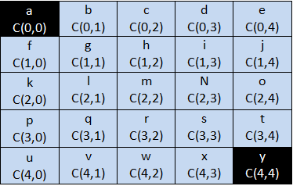
The Minimum Cost Path/Minimum Sum Path Problem
Problem Statement
Given a 2-D MATRIX of ANY SIZE (m x n) and some MOVEMENT CONSTRAINTS, we need to find out the TOTAL NUMBER of POSSIBLE PATHS/WAYS to reach the BOTTOM RIGHT CELL starting from the TOP LEFT CELL in the matrix under the MOVEMENT CONSTRAINTS.
(That’s the Path Count Problem!).
Now, if any COST ASSOCIATED with EACH MATRIX CELL is given, then we need to find out the PATH/S that will COST the MINIMUM to reach the BOTTOM RIGHT CELL starting from the TOP LEFT CELL in that matrix given the same MOVEMENT CONSTRAINTS.
Observations:
- Amount of cost of each cell is positive, so we would like to cover the cells of minimum costs under the given constraints.
In every move, we must maintain/satisfy the given constraints.
The amount of cost associated with a particular path will be the sum amount of the costs of the cells comprising that path.

Slide 2
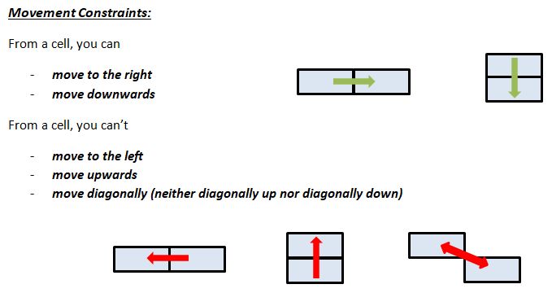
The Minimum Cost Path/Minimum Sum Path Problem Movement Constraints

Slide 3
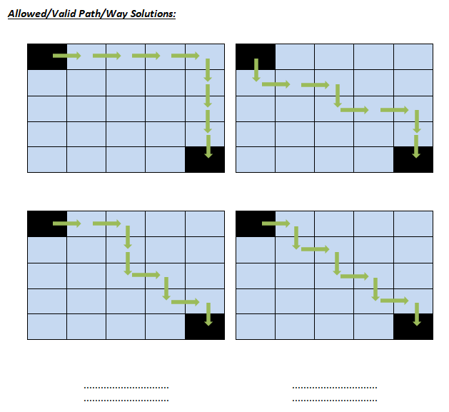
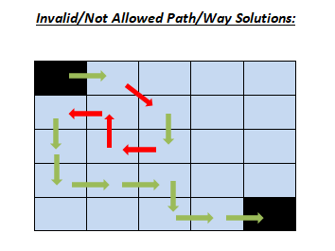
The Minimum Cost Path/Minimum Sum Path Problem Movement Constraints (Contd.)
It is possible to move from a cell(i, j) to
cell(i, j+1) that is straight towards the right cell
or
cell(i+1, j) that is straight towards the below cell

Slide 4
How to Solve The Minimum Cost Path/Minimum Sum Path Problem
How can we calculate the minimum cost to reach the bottom right cell from top left cell and also how can we trace the possible path/s comprising that minimum cost?
It is possible to move from a cell(i, j) to
cell(i, j+1) that is straight towards the right cell
or
cell(i+1, j) that is straight towards the below cell
0,0 | 0,1 | 0,2
1,0 | 1,1 | 1,2
2,0 | 2,1 | 2,2
3,0 | 3,1 | 3,3
It is possible to reach a cell(i, j) from
cell(i, j-1) that is straight from the left cell
or
cell(i-1, j) that is straight from the above cell

Slide 5
The Minimum Cost Path/Minimum Path Sum Problem using Dynamic Programming
DP_Table
We will create a table (2D Array) having
the same dimension as the given 2D grid
to store the results of the sub-problems!
b + a
=
B
c + B
=
C
a
The Grid_Cost
d + a
=
D
e + min(B, D)
=
E
f + min(C, E)
=
F
a | b | c
d | e | f
g | h | i
j | k | l
g + D
=
G
h + min(E, G)
=
H
i + min(F, H)
=
I
j + G
=
J
k + min(H, J)
=
K
l + min(I, K)
=
L
Minimum cost is L units
DP_Table[i][j] = Grid_Cost[i][j] + min(DP_Table[i-1][j], DP_Table[i][j-1])
for valid cells

Slide 6
The Minimum Cost Path/Minimum Path Sum Problem using Dynamic Programming (Contd.)
DP_Table
Example
(0)
(1)
(2)
(3)
(0)
3
5 + 3
=
8
7 +8
=
15
10 + 15
=
25
Grid_Cost
(0)
(1)
(2)
(3)
4 + min(8, 9)
= 4 + 8 =
12
3 + min(15, 12)
= 3 + 12 =
15
6 + 3
=
9
9 + min(25, 15)
= 9 + 15 =
24
(0)
3 | 5 | 7 | 10
6 | 4 | 3 | 9
6 | 5 | 4 | 5
(1)
(1)
(2)
6 + 9
=
15
5 + min(12, 15)
= 5 + 12 =
17
4 + min(15, 17)
= 4 + 15 =
19
5 + min(24, 19)
= 5 + 19 =
24
(2)
Minimum cost to reach the bottom right cell from the top left cell is 24 units!
The path/s associated with the minimum cost (3 + 5 + 4 + 3 + 4 + 5 = 24 units) is
(0, 0) -> (0, 1) -> (1,1) -> (1, 2) -> (2, 2) -> (2, 3)

Slide 7
The Minimum Cost Path/Minimum Path Sum Problem using Greedy Approach
Can greedy approach provide the correct solution for this problem?
- Not always! That’s why greedy approach shouldn’t be the right way to solve this problem
Grid_Cost
Grid_Cost
(0)
(1)
(2)
(3)
(0)
(1)
(2)
(0)
3 | 5 | 7 | 10
6 | 4 | 3 | 9
6 | 5 | 4 | 5
(0)
3 | 5 | 3
4 | 5 | 4
6 | 5 | 3
(1)
(1)
(2)
(2)
The minimum cost is
3 + 5 + 4 + 3 + 4 + 5 = 24 units
and the associated path is
(0, 0) -> (0, 1) -> (1,1) -> (1, 2) -> (2, 2) -> (2, 3)
The minimum cost is
3 + 4 + 5 + 4 + 3 = 19 units
and the associated path is
(0, 0) -> (1, 0) -> (1,1) -> (1, 2) -> (2, 2)
The minimum cost is
3 + 5 + 3 + 4 + 3 = 18 units
and the associated path is
(0, 0) -> (0, 1) -> (0,2) -> (1, 2) -> (2, 2)

